Slide 1
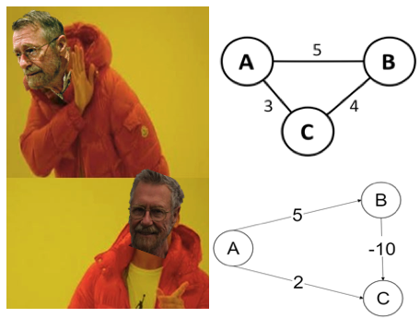
Bellman–Ford Algorithm
Presented by Group 4:
Zadie, Yan, Peng

Slide 2
Algorithm Introduction
Shortest path algorithm
Performs shortest path traversal on a source node from a weighted digraph
Edges can have negative weights and the algorithm can detect negative weight cycles
Real life application: Negative weights can exist in an transportation graph or a discount or rebate is offered for a specific flight or route

Slide 3

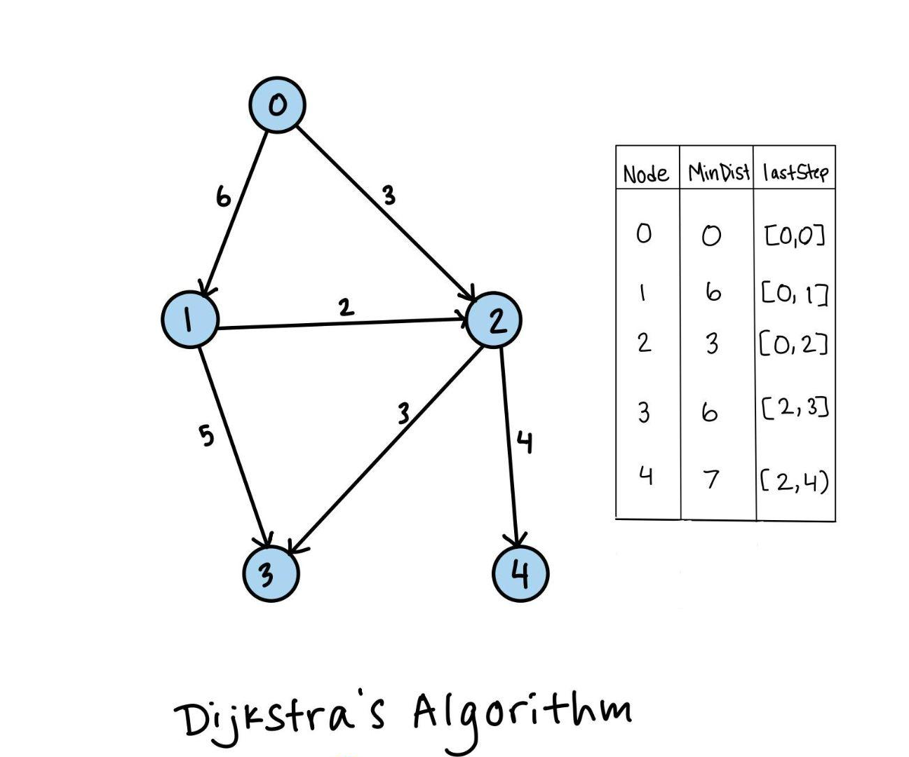

Slide 4
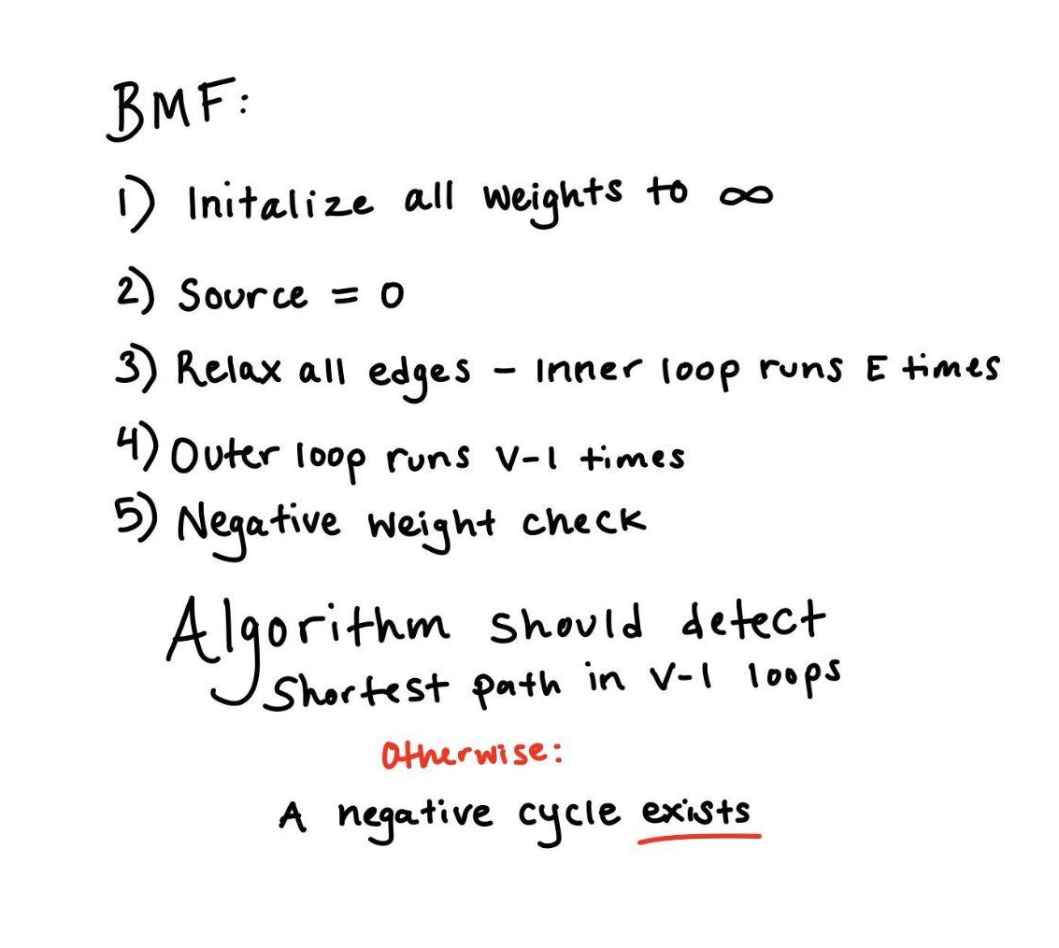

Slide 5
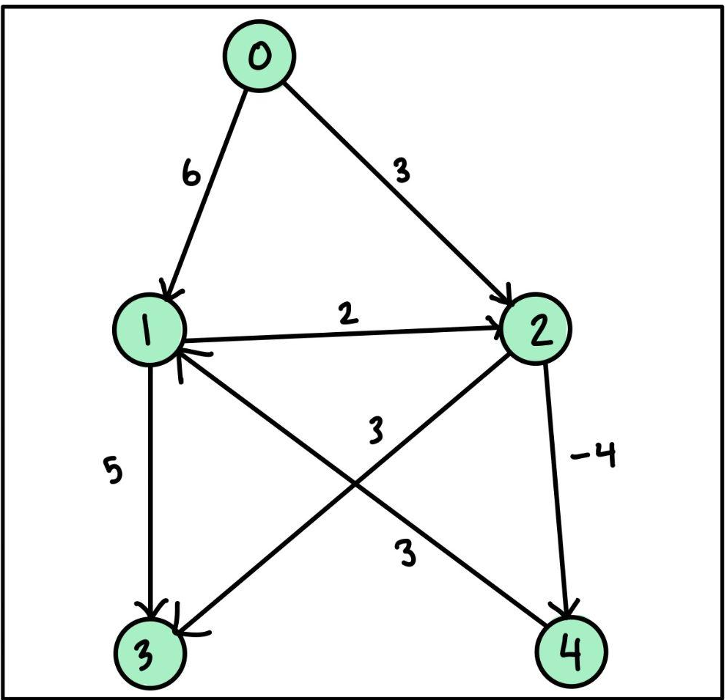
Initialization
Edges | Node | Min Dist
 | 0 | 0
[0,1] [4,1] | 1 | ∞
[0,2] [1,2] | 2 | ∞
[1,3] [2,3] | 3 | ∞
[2,4] | 4 | ∞
New: Handles negative edge weights

Slide 6
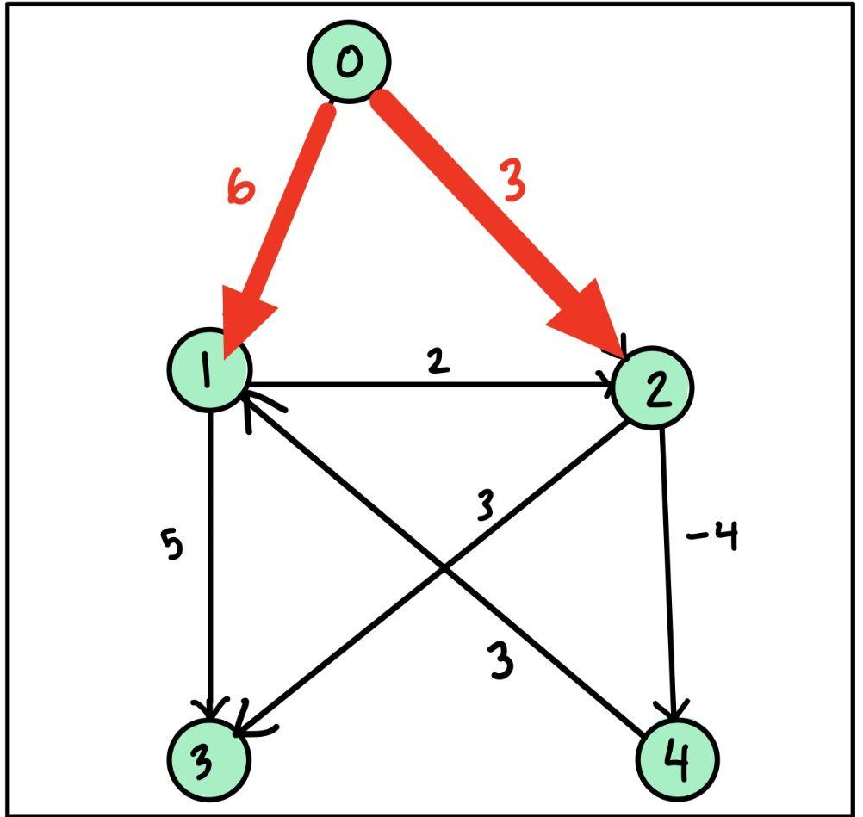
1st Iteration
Edges | Node | Min Dist
 | 0 | 0
[0,1] [4,1] | 1 | 6
[0,2] [1,2] | 2 | 3
[1,3] [2,3] | 3 | ∞
[2,4] | 4 | ∞

Slide 7
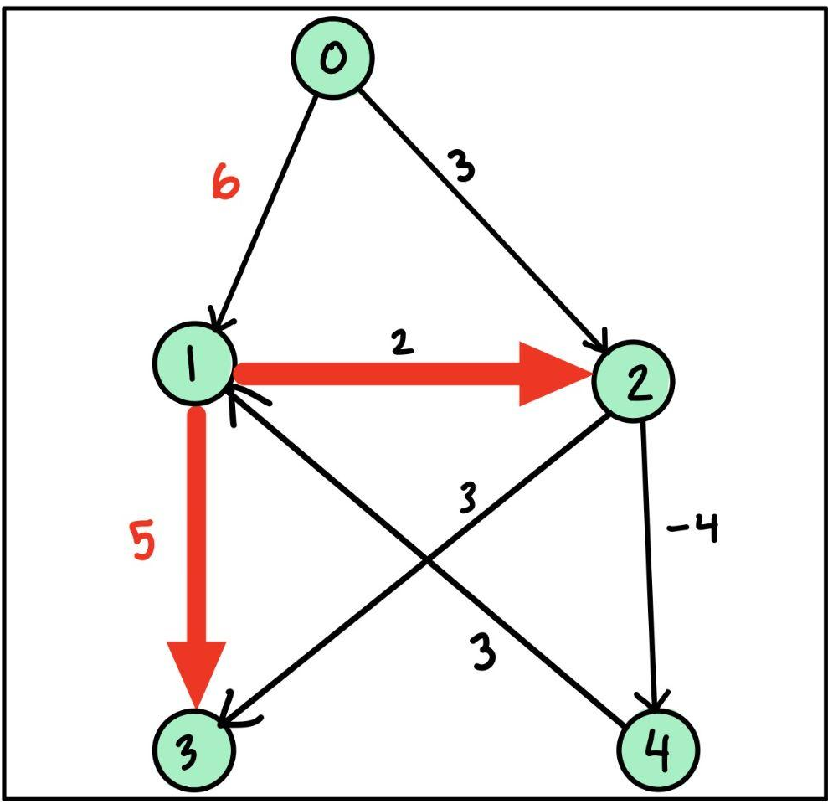
1st Iteration
Edges | Node | Min Dist
 | 0 | 0
[0,1] [4,1] | 1 | 6
[0,2] [1,2] | 2 | 3
[1,3] [2,3] | 3 | 11
[2,4] | 4 | ∞

Slide 8
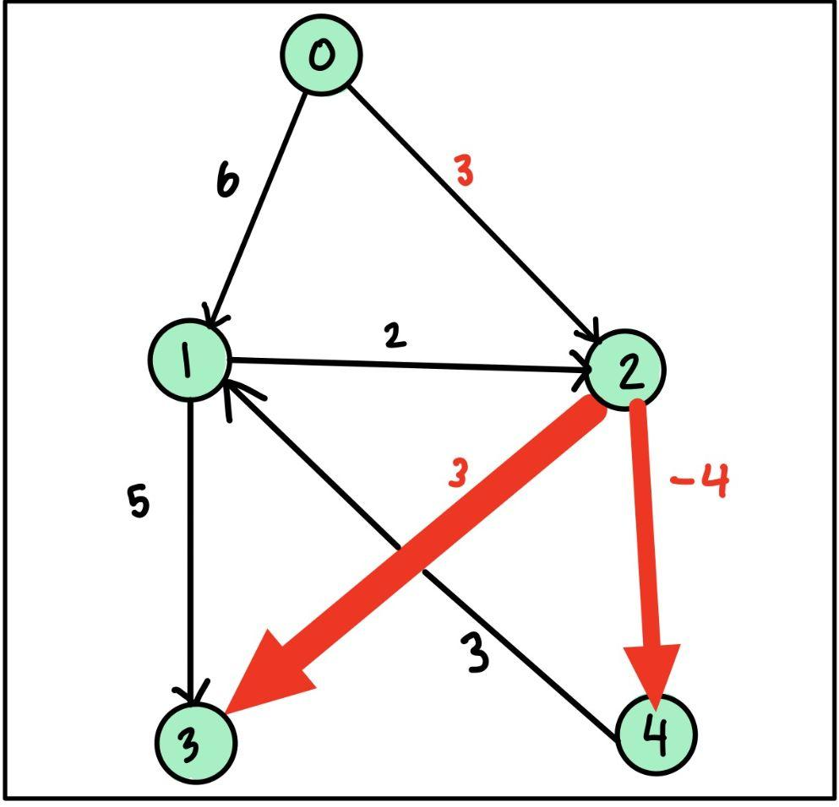
1st Iteration
Edges | Node | Min Dist
 | 0 | 0
[0,1] [4,1] | 1 | 6
[0,2] [1,2] | 2 | 3
[1,3] [2,3] | 3 | 6
[2,4] | 4 | -1

Slide 9
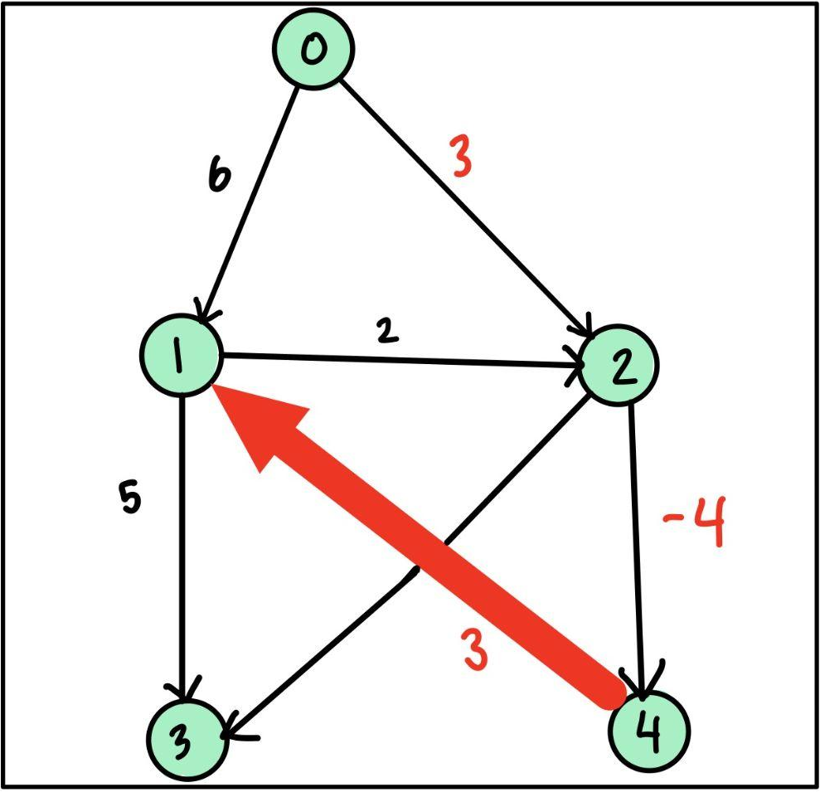
See the pattern?
1st Iteration
Edges | Node | Min Dist
 | 0 | 0
[0,1] [4,1] | 1 | 2
[0,2] [1,2] | 2 | 3
[1,3] [2,3] | 3 | 6
[2,4] | 4 | -1

Slide 10
Now let’s look at a bad implementation…

Slide 11
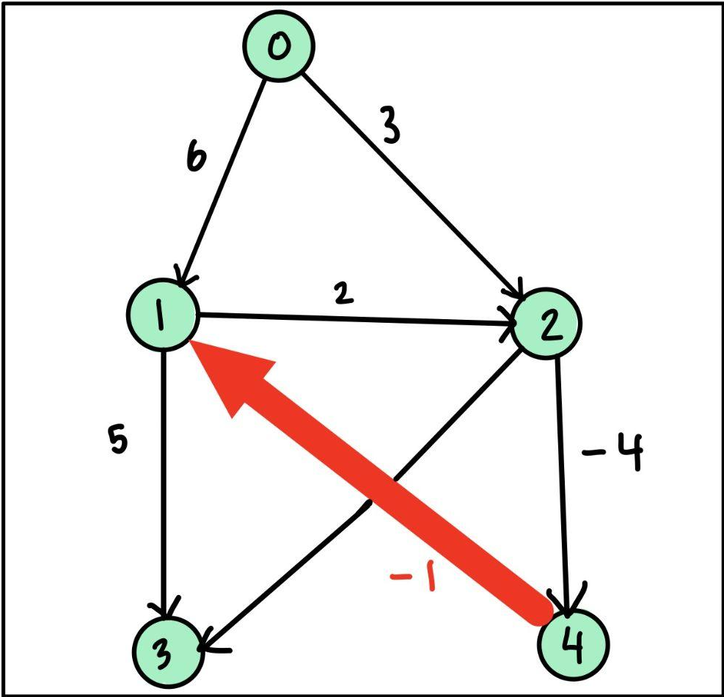
1st Iteration
What if [4,1]
weight is -1?
Edges | Node | Min Dist
 | 0 | 0
[0,1] [4,1] | 1 | -2
[0,2] [1,2] | 2 | 3
[1,3] [2,3] | 3 | 6
[2,4] | 4 | -1

Slide 12
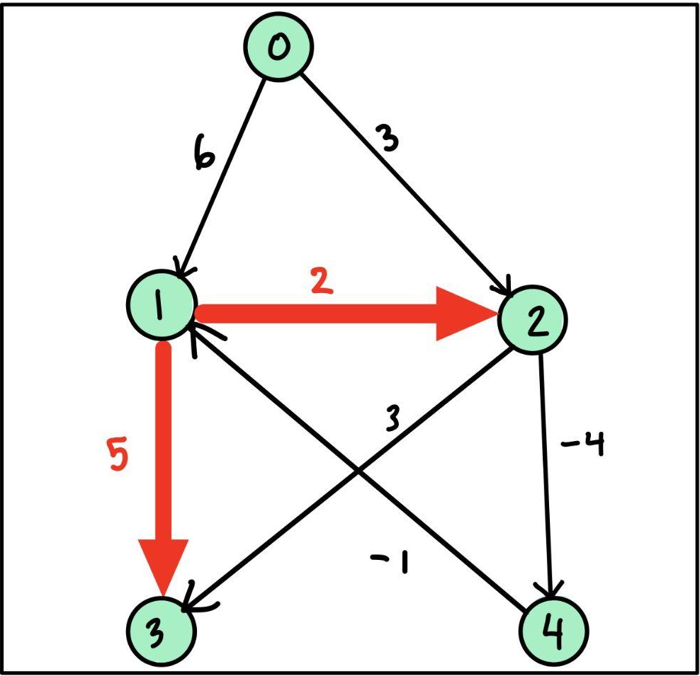
2nd Iteration
Edges | Node | Min Dist
 | 0 | 0
[0,1] [4,1] | 1 | -2
[0,2] [1,2] | 2 | 0
[1,3] [2,3] | 3 | 3
[2,4] | 4 | -1

Slide 13
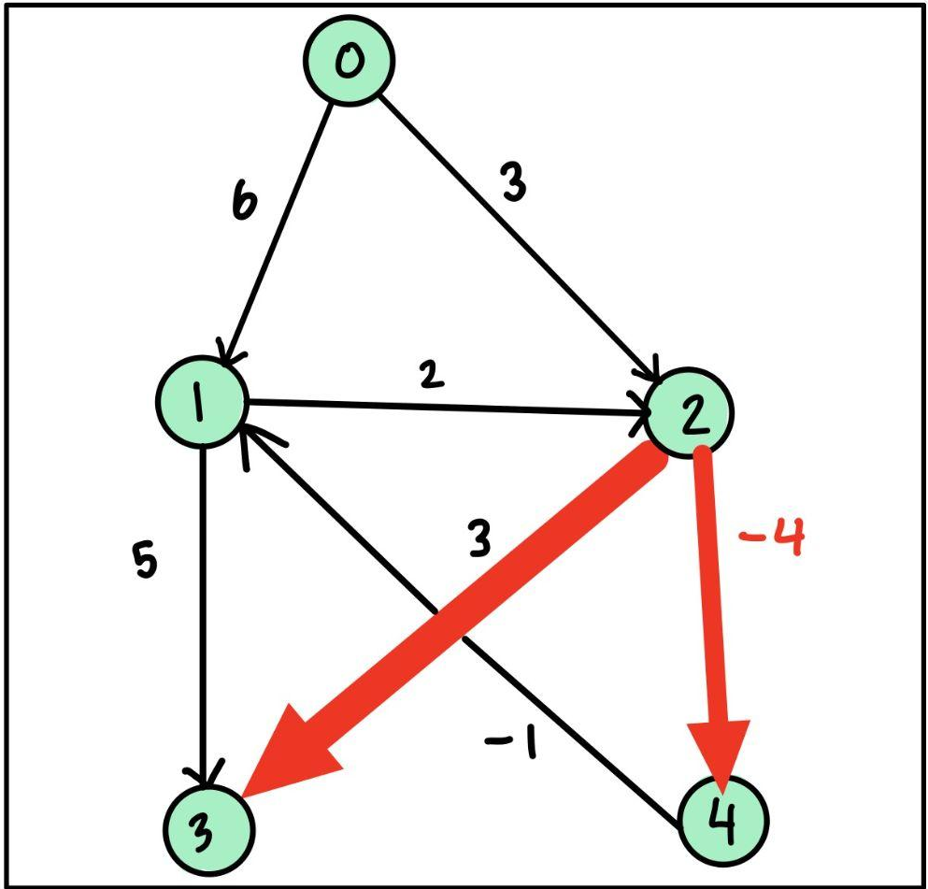
2nd Iteration
Edges | Node | Min Dist
 | 0 | 0
[0,1] [4,1] | 1 | -2
[0,2] [1,2] | 2 | 0
[1,3] [2,3] | 3 | 3
[2,4] | 4 | -4

Slide 14
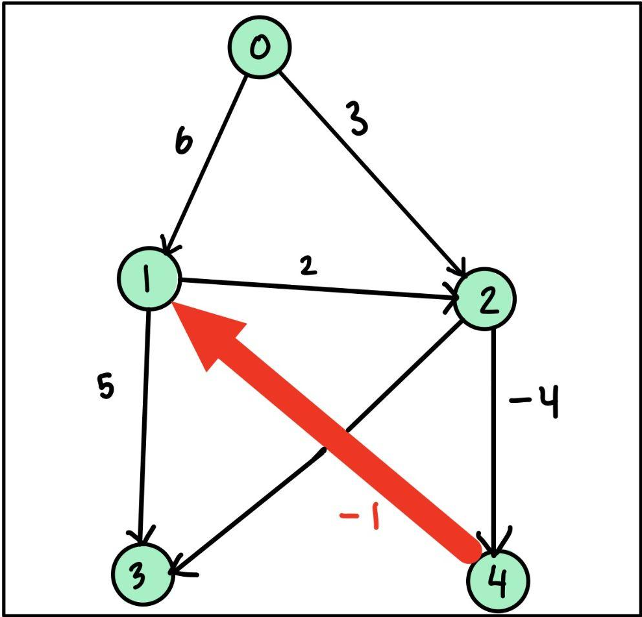
2nd Iteration
Edges | Node | Min Dist
 | 0 | 0
[0,1] [4,1] | 1 | -5
[0,2] [1,2] | 2 | 0
[1,3] [2,3] | 3 | 3
[2,4] | 4 | -4

Slide 15

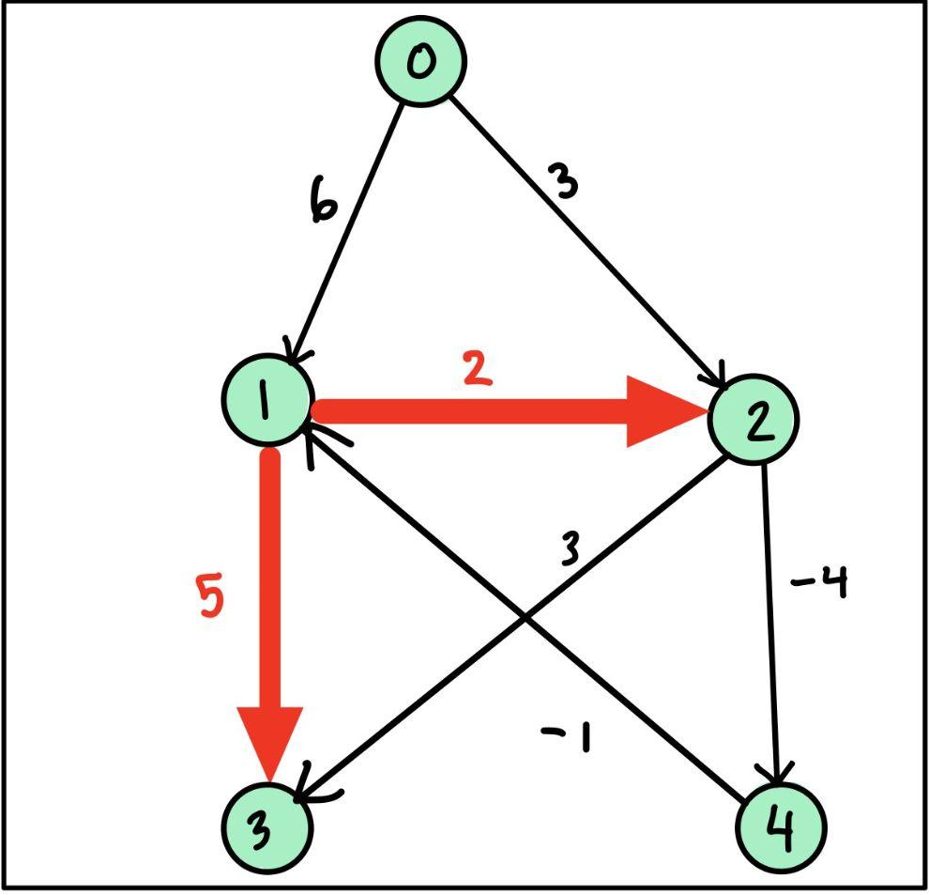
negative weight cycle
3rd Iteration
Edges | Node | Min Dist
 | 0 | 0
[0,1] [4,1] | 1 | -5
[0,2] [1,2] | 2 | -3
[1,3] [2,3] | 3 | 0
[2,4] | 4 | -4

Slide 16
Bellman-Ford Pseudocode:
function BellmanFord(vertices, edges, source): // Step 1: Initialize distances from source to all other vertices as infinity dist = {} for each vertex in vertices: dist[vertex] = infinity dist[source] = 0 // Step 2: Relax edges repeatedly for i from 1 to |vertices|-1: for each edge (u, v, w) in edges: if dist[u] + w < dist[v]: dist[v] = dist[u] + w // Step 3: Check for negative-weight cycles for each edge (u, v, w) in edges: if dist[u] + w < dist[v]: throw "Graph contains a negative-weight cycle" return dist

Slide 17
Time and Space Complexity
Worst case time complexity: O (V³)
Average case time complexity: O(|V| * |E|)
Best case time complexity: O(E)
Space Complexity: O(V + E) for all cases

Slide 18
Thanks for learning with us!

Slide 19
References
A. Shimbel, "Structure in communication nets," in Proceedings of the Symposium on Information Networks, New York, NY, USA: Polytechnic Press of the Polytechnic Institute of Brooklyn, pp. 199-203 1955.
R. Bellman, “On a routing problem,” Quarterly of Applied Mathematics, vol. 16, no. 1, pp. 87–90, 1958.
L. R. Ford Jr., "Network Flow Theory," Paper P-923, Santa Monica, CA, USA: RAND Corporation, 1956.
E. F. Moore, "The shortest path through a maze," in Proc. Internat. Sympos. Switching Theory 1957, Part II, Cambridge, MA, USA: Harvard Univ. Press, 1959, pp. 285-292.
J. Y. Yen, “An algorithm for finding shortest routes from all source nodes to a given destination in general networks,” Quarterly of Applied Mathematics, vol. 27, no. 4, pp. 526–530, 1970.
M. J. Bannister and D. Eppstein, “Randomized speedup of the bellman–Ford algorithm,” 2012 Proceedings of the Ninth Workshop on Analytic Algorithmics and Combinatorics (ANALCO), 2012.
“Bellman–Ford algorithm,” Wikipedia, 27-Feb-2023. [Online]. Available: https://en.wikipedia.org/wiki/Bellman%E2%80%93Ford_algorithm. [Accessed: 23-Mar-2023].

